Slide 1
QMST 5335
Course Overview and Introduction to Forecasting

Slide 2
Learning Objectives:
Course overview
  Description, materials, requirements
  Syllabus details and methodology
Forecasting
  What is forecasting? The steps involved!
  Main forecasting approaches
  Judgemental forecasting approaches and how they work

Slide 3
Outline
Course Overview
  Course Description, Materials, Delivery, and Schedule
  Course Requirements and CANVAS Site
Introduction to Forecasting
  Forecasting, Forecasting Horizon, and Forecasting Task
  Forecasts and Forecasting Methods
  Qualitative (Judgmental) Forecasting
  Quantitative Forecasting

Slide 4
Outline
Course Overview
  Course Description, Materials, Delivery, and Schedule
  Course Requirements and CANVAS Site
Introduction to Forecasting
  Forecasting, Forecasting Horizon, and Forecasting Task
  Forecasts and Forecasting Methods
  Qualitative (Judgmental) Forecasting
  Quantitative Forecasting

Slide 5
Course Description
This course introduces the concepts and principles of forecasting and simulation techniques as applies to planning and decision making in organizations. Topical coverage includes time series forecasting, casual forecasting, discrete event simulation, and continues-event simulation techniques.
What you will acquire in this course:
  Understanding forecasts and forecasting process
  Learning the basics of time series and casual forecasting methods
  Learning how to evaluate forecasts
  Understanding the basics of simulation and designing simulation models
  Learning basics of queueing models
  Designing discrete-event simulation for analyzing various systems
  Analyzing input and output data using simulation models

Slide 6
Course Materials: Textbooks
Required Textbooks:
Required Textbook 1 - FPP: “Forecasting Principles and Practice”, 3rd Edition, by Rob Hyndman and George Athanasopoulos. Published by OTexts: Melbourne, Australia. OTexts.com/fpp3.
  Available free at: https://otexts.com/fpp3/
Required Textbook 2 - SS: “Simio and Simulation: Modeling, Analysis, Applications”, 6th Edition, by Jeffrey S. Smith, David T. Sturrock and W. David Kelton.
  Available free at: https://textbook.simio.com/books/SASMAA6.php#download
  The textbook has student resources at https://www.simio.com/publications/SASMAA/students/
  To access the student resources, use username student and password Reg!stered5tudent . Further details are available in the Preface of the textbook.

Slide 7
Course Materials: Software
Required Software:
Required Software Set 1: A Windows or MAC laptop with an installation of MS Excel 2016 or later (no trial versions or earlier versions acceptable). Also, other MS Office programs, PowerPoint and Word, and Adobe for pdf documents are required.
  Please check information on installing Office 365: http://www.txstate.edu/office365/
  We will use MS Excel extensively in forecasting and simulation portions.
  You will need to add the following ToolPaks:

Slide 8
Course Materials: Software
Required Software:
Required Software Set 1 (cont’d):
  You will need to add the following ToolPaks:
    Data Analysis ToolPak. See https://support.office.com/en-us/article/use-the-analysis-toolpak-to-perform-complex-data-analysis-6c67ccf0-f4a9-487c-8dec-bdb5a2cefab6 for how to load and activate the Analysis ToolPak as well as the basics of its functions. We will review how to use some of these functions as we need. Students are encouraged to use the above link if they need reference for the functions we use.
    Solver Add-in: See https://support.office.com/en-us/article/load-the-solver-add-in-in-excel-612926fc-d53b-46b4-872c-e24772f078ca for how to load the Solver Add-in. We will briefly use it and https://support.office.com/en-us/article/define-and-solve-a-problem-by-using-solver-5d1a388f-079d-43ac-a7eb-f63e45925040 has basic instruction. https://www.excel-easy.com/data-analysis/solver.html has additional information. We will review how to use some tools of Solver Add-in as needed.
  Once they are loaded, both tools will be shown in Data tab.
  Course assignments require submitting Excel, Word and/or pdf, and PowerPoint documents.

Slide 9
Course Materials: Software
Required Software:
Required Software Set 2: You will need to download and install Simio software, Free Simio Personal Edition. We will use Simio after Spring break, so the students are advised to install Simio before Spring break.
  To download: https://www.simio.com/download/simio.php
  In addition, we will use Stat::Fit software.
    Go to https://www.simio.com/publications/SASMAA/students/ and scroll down to Supplemental Software section and download the ‘textbook version of Stat::Fit. You do not need to install it. After extracting the files, you can directly run the application file.

Slide 10
Course Delivery and Schedule
The course is organized in three main modules:
  Module 1 – Forecasting – Weeks 1-6
  Module 2 –Queueing Models and Simulation Basics – Weeks 7-11
  Module 3 – Simulation Modeling and Simio – Weeks 11-16
Each module covers several weeks
  Each week within a module focuses on a main topic from the theme of the module.
  For each week within each of module, there will be a page posted on CANVAS under the module.

Slide 11
Course Delivery and Schedule
Weekly Class Meetings:
Mondays, 6:30pm-9:20pm
In this course, there are three distinct modes of attendance. Class mode can be found in class schedule posted on course Canvas Home page:
Mode 1: Hybrid In-Person (San Marcos & Round Rock)
  San Marcos students will attend the class in-person at our San Marcos location.
  Round Rock students will attend in-person at our Round Rock location and join the live class held in San Marcos via video conferencing.
Mode 2: Hybrid In-Person (Round Rock & San Marcos)
  Round Rock students will attend the class in-person at our Round Rock location.
  San Marcos students will attend in-person at our San Marcos location and join the live class held in Round Rock via video conferencing.
Mode 3: Online via Zoom
  The class will be conducted entirely online over Zoom.

Slide 12
Course Delivery and Schedule
Weekly Office Hours (over Zoom):
Mondays, 4:00-6:00pm every week
All the office hours will be conducted over Zoom. You can find the Zoom links for office hours in the course Canvas page and the course syllabus.
Join office-hours to ask questions, participate in possible discussions, etc.
Homework assignments are typically due before the class meetings, so office-hours are great for asking last questions before submitting your homework assignments!
Pre-recorded Lecture videos:
For some of the weeks, the instructor may post pre-recorded lecture videos or direct the students to watch some videos.

Slide 13
Course Delivery and Schedule
Weekly Flow:
To succeed in this course and not to fall behind, the students are encouraged to follow the weekly schedule and complete the week’s learning tasks.
A typical week’s flow is as follows:
  The week’s page on CANVAS under the corresponding module includes all the learning tasks and materials and pre-recorded online video links, if any.
  The students review the materials and watch the pre-recorded online videos (if any).
  The students attend the online live class-meeting or come to the classroom.
  The students complete the week’s learning tasks and work on the related assignment.
  The students submit the assignment (if any) before the class-meeting.
Throughout each week, the students are encouraged to join the office hours

Slide 14
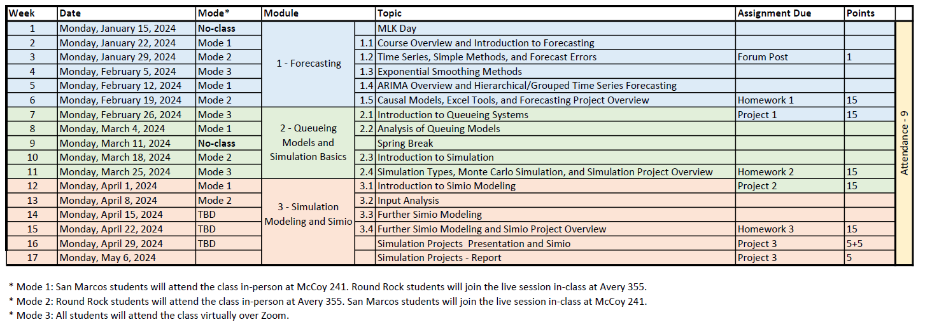
Course Delivery and Schedule
Outline of the schedule:
  Things might change! I will make announcements accordingly

Slide 15
Course Delivery and Schedule
Communication:
  Check your emails! Check the CANVAS site.
    It is student’s responsibility to follow the CANVAS site and university emails for course related announcements
  Communication channels:
    Email: When you email the instructor during the weekdays, expect to get a response within 24-36 hours. If you do not get a response after 36 hours, send the second email. Note that during the weekends, there might be delays in responses. If there is an urgent situation, please try the other communication channels (see below).
      About questions related to assignments: Please send emails about your questions related to the assignments in a timely manner and allocate time for the response as well as for yourself to incorporate any feedback by the instructor. It is student’s responsibility to contact with the instructor on a timely manner. For instance, emailing a question about a homework on the day it is due or just couple of hours before its submission deadline is not a feasible approach.
      When you email the instructor, in the subject line of the email, please note QMST 5335 and then the subject briefly. Emails without QMST 5335 in the subject risk being lost in a mass of unsorted messages.
    Office phone: As the instructor is teaching other courses and might have other faculty responsibilities, the instructor might not be in my office all the times. If the instructor does not answer, please leave a voice mail. The instructor will not be in the office most late afternoons and weekends.

Slide 16
Course Requirements
Forum Post (1% of the total)
  Students should read the syllabus, and post in the introduction forum introducing themselves and noting they read the syllabus
    Good opportunity to introduce yourself, interact with other students, and maybe start forming project teams!
    Post by 2nd week’s class-meeting
Homework Assignments (45% of the total)
There will be 3 homework assignments in total
  Each homework is 15%
  Homework assignments are individual assignments
  The dates are posted and the details of the homeworks will be posted
  Students are recommended to start homework assignment as soon as possible
    Ask questions, if needed, to the instructor in a timely manner
    Utilize the office hours before the submission to ask final questions
    Submit on time! Late submissions will not be graded
Attendance (9% of the total)
  Random attendance taken throughout the semester. Your absence from class will not be excused unless you have a valid and verifiable reason for missing it. You need to let me know at least 48 hours prior to the class time about your absence.

Slide 17
Course Requirements
Projects (44% of the total)
There will be 3 project assignments
Project assignments are team assignments!
  Project 1 (15%) is an individual project
    Project 1 is about forecasting
  Project 2 (15%) is an individual project
    Project 2 is about Monte-Carlo simulation
  Project 3 (14%) is a team project
    Project 3 is about Simulation modeling
Students are encouraged to ask questions about projects during office hours

Slide 18
Course Requirements
Grading:
You can request regrading if you believe that I made a mistake in grading your assignment
  To do so, email the instructor within 3 days following the announcement of the grade (after that, the grade of the assignment is not going to change).
  In your email, specify the parts you want to be regraded referring to the solutions posted
  Note: Partial credits from the sections of the assignments are typically not negotiable as the assignments include numerical analyses
  Note: Regrading is not resubmission, it is just to avoid the cases where I make a mistake
    Summation mistake maybe? Did not see your file maybe? Did not see something on your file maybe?....
Makeups: No makeups for the homework assignments and no makeups for the project submissions! These assignments will have approximately one-week time window (even more!). Please plan accordingly
There is no exam in this course.

Slide 19
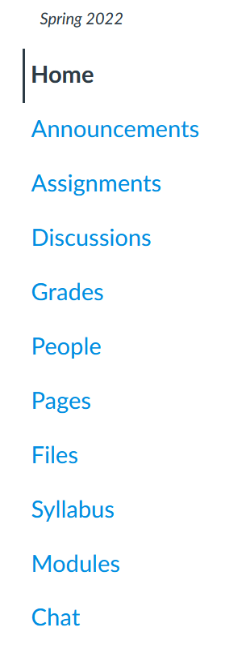
CANVAS Site
CANVAS tools:
Course overview, outline
Announcements are here
See homework/project dues, submit the assignments here
Discussion forums! Introduce yourself here and form teams!
See your grades here
All course files here
Syllabus file here
Weekly pages for the modules!

Slide 20
Outline
Course Overview
  Course Description, Materials, Delivery, and Schedule
  Course Requirements and CANVAS Site
Introduction to Forecasting
  Forecasting, Forecasting Horizon, and Forecasting Task
  Forecasts and Forecasting Methods
  Qualitative (Judgmental) Forecasting
  Quantitative Forecasting

Slide 21
Forecasting
Forecasting is about predicting the future as accurately as possible
  It accounts for all of the information available, including historical data and knowledge of any future events that might impact the forecasts.
Forecasting is required in many situations:
  Deciding whether to build another power generation plant in the next five years requires forecasts of future demand
  Scheduling staff in a call center next week requires forecasts of call volumes
  Stocking an inventory requires forecasts of stock requirements
  Demand forecasting forms the basis for all planning decisions in a supply chain
Goals are what you would like to have happen.
  Goals should be linked to forecasts and plans
Planning is a response to forecasts and goals.
  Planning involves determining the appropriate actions that are required to make your forecasts match your goals.

Slide 22
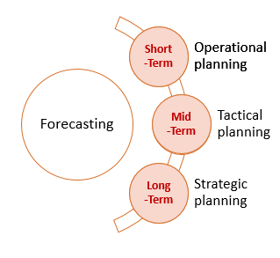
Forecasting Horizon
Time horizon in forecasting:
  Short-term forecasting (days/weeks)
    Used for short-term operational planning
    Such as inventory management, material requirements planning, scheduling of personnel, production and transportation.
  Intermediate-term forecasting (weeks/months)
    Needed to determine future resource requirements, in order to purchase raw materials, hire personnel, or buy machinery and equipment.
    Used for sales patterns, resource requirements, labor management
  Long-term forecasting (months/years)
    Used in strategic planning. Such decisions must take account of market opportunities, environmental factors and internal resources.
    Capacity management, long-term production planning

Slide 23
Forecasting Task
Basic steps in a forecasting task:
  Problem Definition: Why needed? Who will use them? For what? What will be the effects of forecasts?
  Gather information: Collect all the data! Statistical data and input from experts. Know the dynamics!
  Preliminary analyses: Analyze the data, observe patterns (trends, seasonality, cycles, etc.), observe relations.
  Choose and fit model: Depending on the data and the dynamics, fit and compare couple of models, and select a final model to use.
  Use and evaluate: Use the model and evaluate it continuously (check the accuracy as new information becomes available), make changes in the model specifications as needed (or maybe change the model)

Slide 24
Forecasts
Characteristics of forecasts:
  Forecasts are always inaccurate and should thus include both the expected value of the forecast and a measure of forecast error
  Long-term forecasts are usually less accurate than short-term forecasts
    Predicting the further future is more difficult!
  Aggregate forecasts are usually more accurate than disaggregate forecasts
    Forecasting the demand for Large-brown pants vs. forecasting the demand for Large-pants
    Forecasting the sales in one outlet vs. forecasting the total sales
A good forecast is:
  Timely and in meaningful units
  Reliable and as accurate as possible
  Easily determined and documented

Slide 25
Forecasting Methods
The appropriate forecasting methods depend largely on what data are available
Qualitative/Judgmental forecasting methods:
  Typically, used when statistical methods do not apply
  Or, can be used to modify forecasts from other methods
Quantitative forecasting methods:
  Can be used when:
    Numerical information about the past is available
    It is reasonable to assume that some aspects of the past patterns will continue into future

Slide 26
Judgmental Forecasting
Forecasting using judgement is common in practice:
  There are no available data, so that statistical methods are not applicable and judgmental forecasting is the only feasible approach
    No data, incomplete data, delayed data
  Data are available, statistical forecasts are generated, and these are then adjusted using judgement;
  Data are available and statistical and judgmental forecasts are generated independently and then combined.
Judgmental forecasts are:
  Subjective, so not unbiased
  Can be inconsistent as they heavily depend on someone’s perception
  Based on a person’s own experiences and can lean towards initial/previous knowledge

Slide 27
Judgmental Forecasting
Need to be systematic when using judgmental forecasting methods:
  Define the forecasting task clearly
  Adopt a systematic approach
  Document and justify
  Systematically evaluate forecasts
  Segregate forecaster and user
Some judgmental forecasting methods:
  Delphi method
  Forecasting by analogy
  Scenario forecasting
  New product forecasting

Slide 28
Judgmental Forecasting Methods
Delphi method: The method relies on the key assumption that forecasts from a group are generally more accurate than those from individuals. The aim of the Delphi method is to construct consensus forecasts from a group of experts in a structured iterative manner.
  A panel of experts is assembled.
  Forecasting tasks/challenges are set and distributed to the experts.
  Experts return initial forecasts and justifications. These are compiled and summarized in order to provide feedback.
  Feedback is provided to the experts, who now review their forecasts in light of the feedback. This step may be iterated until a satisfactory level of consensus is reached.
  Final forecasts are constructed by aggregating the experts’ forecasts.

Slide 29
Judgmental Forecasting Methods
Forecasting by analogy: Thinking and discussing analogous products or situations can generate useful (and sometimes crucial) information.
  A common example is the pricing of a house through an appraisal process
  Structured analogy: similar to Delphi method, but ask experts to use analogy
Scenario forecasting: Generate forecasts based on plausible scenarios.
  Building forecasts based on scenarios allows a wide range of possible forecasts to be generated and some extremes to be identiied
  Decision makers often participate in the generation of scenarios
New product forecasting: Historical data is not available, so judgmental methods can be used. In addition to the other judgmental methods:
  Sales force composite: each store/outlet forecasts individually, then these are aggregated
  Executive opinion: Top of the management generates forecasts
  Customer intentions: Survey customers and use the results

Slide 30
Quantitative Forecasting
Quantitative forecasting methods can be used when:
  Numerical information about the past is available
  It is reasonable to assume that some aspects of the past patterns will continue
There are many quantitative forecasting methods, and they use either time-series or cross-sectional data
  Time series data: collected at regular intervals over time for a particular value
    Daily sales over two years, monthly consumption over 5 years, annual GDP over 50 years…
  Cross-sectional data: collected at similar times from different sources
    Profits of Fortune 500 companies, 2020 GDP of the countries…
Common classes of quantitative forecasting methods:
  Causal forecasting methods: Use historical data and/or other factors
    Regression models, prediction models (e.g., weather forecasting)
  Time series forecasting methods: Use historical data (time series)
    Simple methods, Exponential smoothing methods, ARIMA
  Or a mix of these methods…

